Slide 1


What is Community Life Engagement
(CLE)?
All the ways that people with IDD access and participate in their communities, outside of employment, as part of a meaningful day. ​
An outcome, not a service
Non-work​ (although it can be a pathway)
Accessing typical community facilities (library, gym, rec center, etc.)​
Volunteerism ​
Post-secondary &/or continuing education​
CLE TOOLKIT - CLE-Toolkit (communityinclusion.org)
Notes:
Jen
An outcome, not a service
All the ways that people with IDD access and participate in their communities, outside of employment, as part of a meaningful day.
Non-work
Accessing typical community facilities (library, gym, rec center, etc.)
Volunteerism
Post-secondary &/or continuing education
Wrap-around to work
Pathway to work
Retirement activities

Slide 2




CLE Guideposts of Support
1
Individualize supports for each person.
2
Promote community membership and contribution.
3
Build skills and facilitate relationships to decrease reliance on paid staff.
4
Ensure that supports are outcome-oriented and monitored.

Slide 3

How does CLE relate to employment?
Can provide a pathway to employment through career exploration, skill building & networking
Wraps around employment to fill gaps in time, experience, social connection
Supports people in retirement in integrated ways
Notes:
Jen
In addition to having value in its own way, CLE relates to work in these ways

Slide 4
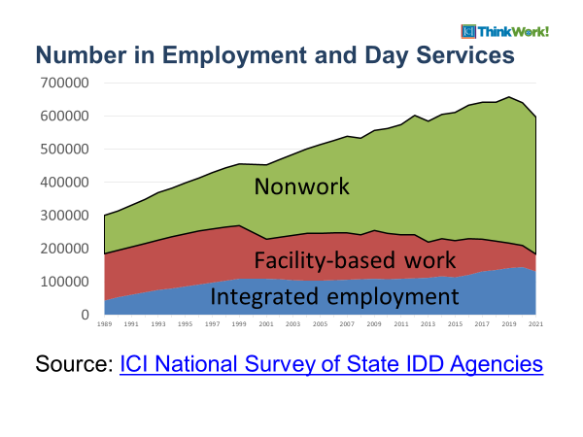
Number in Employment and Day services 1989 through 2021
Most people are here!
So, what are we doing?
Notes:
Agnes/Jean
This slide represents trend data going back to fiscal year 1989 through 2021 and allows us to see a series of trends.
The first trend is that over time more and more adults have had access to employment and day services. From an estimated 287, 860 unduplicated individuals receiving employment and day services in 1989 to a high of 657,826 in 2019 immediately prior to the covid-19 public health emergency. The total dropped by a little more than 60,000 during the public health emergency, which given the challenges in providing services during that time suggests that state agencies and service providers rapidly adapted their service models. And the second trend demonstrates that slowly overtime facility-based work has declined and integrated employment has increased.

Slide 5
Envision a Potential Holistic Flow of Services
Discovery/Exploration
Job Development and Placement
Post-hire Supports
Wrap-around Supports
Community Life Engagement
(when people aren’t working)
Person-centered, based on interests, skills and abilities
Integrated settings, community-based exploration
Building relationships
Self-advocacy
Volunteerism
Small-d discovery
Travel training
Safety skills
Socialization
Retirement activities
Focused on outcomes, not just plugging into activities
Recreation (not first on list)
Individualized (one job seeker at a time)
Get to know the job seeker by discovering their ideal conditions for employment
Community-based assessment and trials
Benefits counseling
Transportation options explored
Profile completed
30-day job placement plan developed
Includes specific action items
Employer outreach is based on network contacts in placement plan
Contacts lead to meetings/interviews
Plan reviewed every 30 days and updated
Placement- based on match between skills, preferences and job position
Initial natural supports identified
Initial placement supports
Follow-along supports
Level of job coaching fades
Employment support plan includes employee and employer
Earnings properly reported to Social Security
Identify new career planning goals
Wrap-around supports provided when people are not working to make a meaningful week
Note: a person can enter or re-enter at any point in this process

Slide 6
New Adults
Everyone goes through new Flow of Services
One Person at a Time
Employment
New TYs
Day Program(s)
Updated Service Structure
Pilot

Slide 7

The Power of a Pilot!
Allows you to start small
Figure out your new flow (process, tools, policies, workflows, etc.)
Identify where people are in your flow of service
Gather and use data
  (outcomes, operations, staffing, hiring/onboarding, program costs, needed funding etc.)
Identify gaps
Build out projected budgets based on service projections (see spreadsheet)
Leverage grant/bridge funds
Strategically manage growth
But….you have to scale up or that pilot is just extra work with potentially no extra revenue
Notes:
Typically, budgets are created using historic data….if you’re doing something new, you won’t have data. A pilot allows you to do this. Must look carefully and holistically at what resources you will need to be successful.

